Slide 2
God’s Promise for the week
“… I have called you
by your name …
It is I who arm you.”
(Is 45:4b, 5b)
Notes:
2

Slide 3
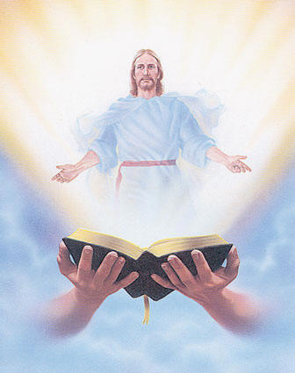
Welcome
Guest

Slide 4
ANNOUNCEMENTS
Oct. 20, 2017

Slide 5
November 2017 MAGNIFICAT ISSUE
is available for
distribution tonight
at the Auditorium.

Slide 6
2018 Magnificats Renewal
Deadline: Oct 20, 2017
Please submit orders and payments per Ministry/or M.E. class to Marc / Emma.
Notes:
DEADLINE for submitting orders and payment will be OCTOBER 20, 2017. We apologize but WE WILL NOT ACCEPT ORDERS AFTER THE DEADLINE.
Rate are still the same:
1) English - $20.00/year
2) Spanish - $15.00/year
3) Magnifikids - $12.30/year
4) Large prints (English) - $40.00/year
We would appreciate if everyone will COMPLY with the deadline

Slide 7
TEACHINGS
New Creation Realities /
Growth in Prayer - LSS 1- 48
Gifts and Fruit of the Holy Spirit
- LSS 1- 47
Advanced Intercession -LSS 1- 45
Sat., Oct. 21, 2017, 1- 5 pm
@ DMP Classrooms

Slide 8
MARK 10
Parade of Saints
Friday, October 27, 2017
Divine Mercy Parish
Notes:
Please bring candies and or treats for the children at the fellowship.

Slide 9
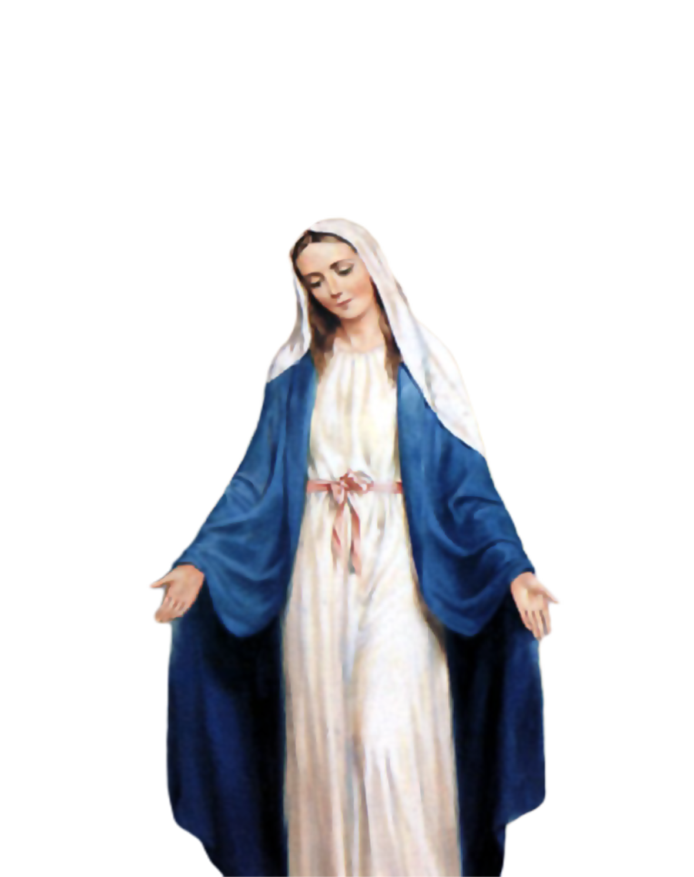
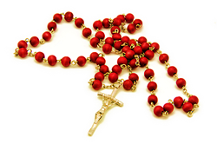
2000 HAIL
MARY
Saturday, October 28
Start - 8:30am
DMP Library

Slide 10
What is God’s plan
in our married life?
Join the…
Marriage Encounter
Weekend #49
Nov. 17-19, 2017
Hotel Executive Suite
30 Minue Street
Carteret, NJ 07008
Please email us at mla@bldnewark.com
BLD Newark

Slide 11
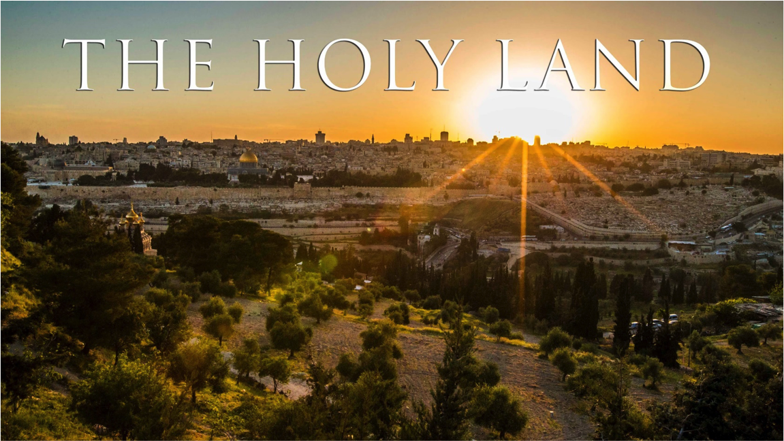
Support the
BLD Newark 2017
Fundraiser !!!
Get a chance to win a trip
for 2 to Holy Land!
Raffle date is Friday
November 10, 2017
Notes:
Just $2 a ticket, your friends and family will have a chance to win the top prize of a trip to the Holy Land!

Slide 12
Marshaling
Schedule
Oct. 27, 2017
Mission
Apostolate

Slide 13
ORDER
“ Give to God what belongs to God.”
(Mt 22:21)

Slide 14
DIRECTIONS
Respect authority that conforms to the order established by God
2. Observe the social
teachings of the Catholic
Church.

