Slide 1
ANNOUNCEMENTS
Nov. 1, 2019

Slide 2
God’s Promise for the week
“The Lord lifts up all who are falling and raises up all who are bowed down.”
Ps 145: 14
Notes:
2

Slide 3
Welcome
Guest

Slide 4
December 2019
Magnificat Issue
is available for distribution tonight in the Auditorium

Slide 5
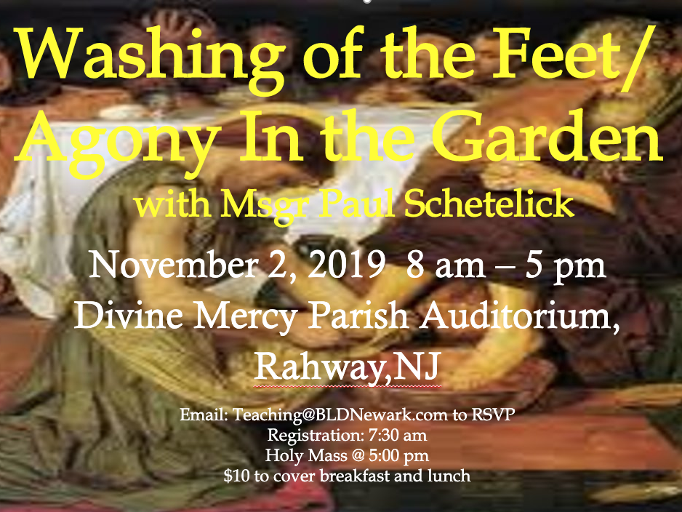

Slide 6
LSS #52
Grand Reunion
Nov. 9, 2019
12 pm – 4pm
Divine Mercy Parish Library

Slide 7
TEACHINGS
Apologetics II – ME 48 / SPE 19
Encounter with Jesus – ME 47 / ME 49 / ME 50
Basic Bible Seminar – ME 51 & 52 / SPE 19 / SE 39
Gifts & Fruits of the Holy Spirit – SPE 20
Sat., Nov. 16, 2019, 1- 6 pm
@ DMP Classroom

Slide 8
Prayer Healing
Seminar II
Nov. 23 - 24, 2019 7 am – 6 pm
2nd floor Library,
Divine Mercy Parish, Rahway, NJ
REQUIREMENT: MUST HAVE ALREADY ATTENDED PRAYER HEALING SEMINAR I
Email prayer.healing@BLDNewark.com to RSVP, or
Register online at www. BLDNewark.com and click on
Prayer Healing Seminar II flyer
Notes:
All graduates of Prayer Healing Seminar 1 are invited to participate in the second part of this 2-part seminar /retreat.
Email prayer.healing@BLDNewark.com to RSVP, or Register online at www. BLDNewark.com and click on Prayer Healing Seminar II flyer

Slide 9
ME #53
Grand Reunion
Dec. 7, 2019
12 pm – 5pm
Divine Mercy Parish Library

Slide 10
FRIDAY, JANUARY 24, 2020
Washington DC

Slide 11
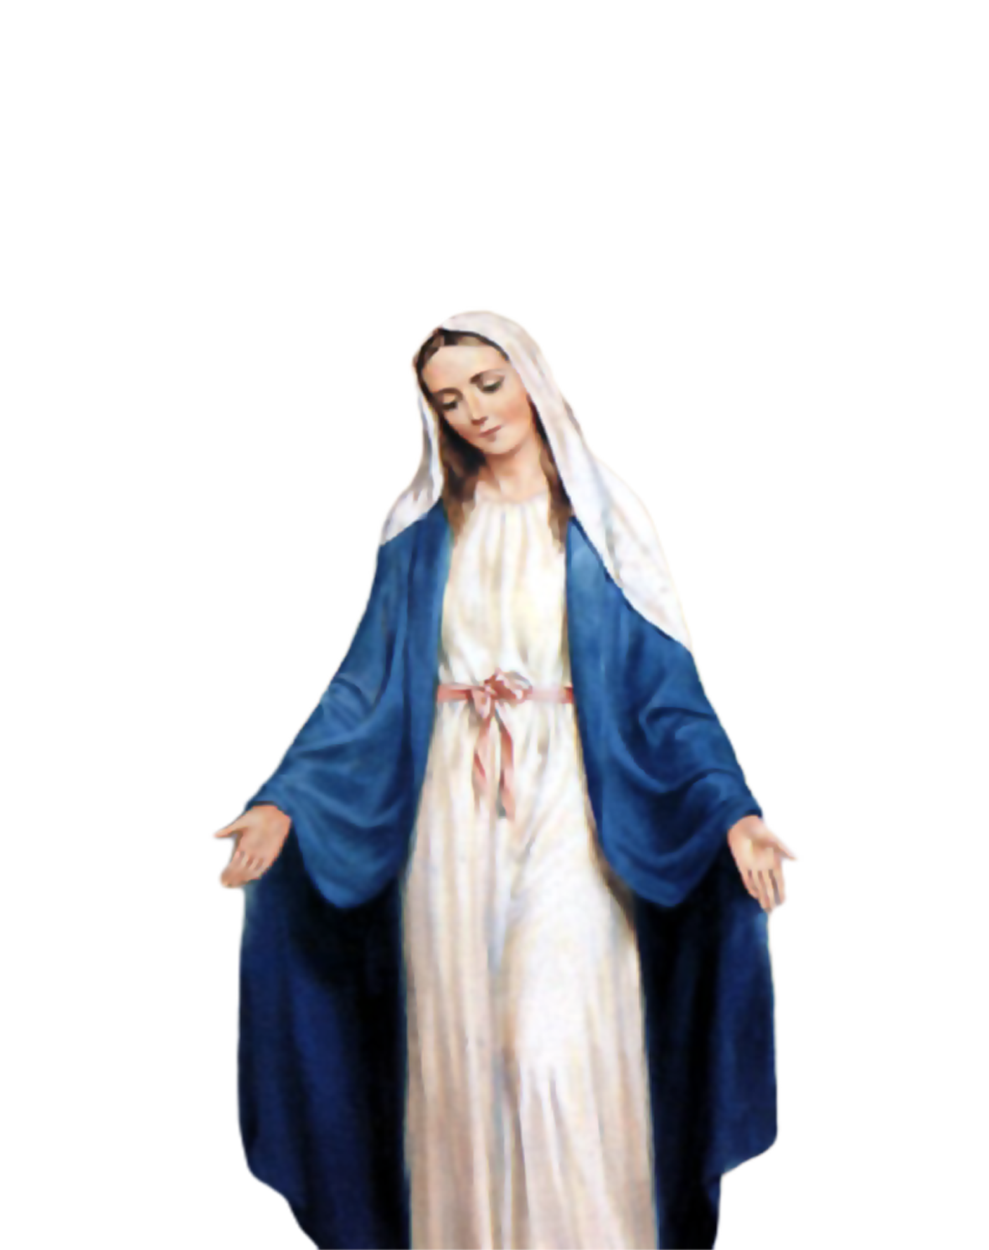
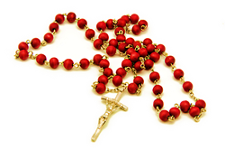
Medical Mission 2020
Jordan, Guimaras, Philippines
February 10 to 13, 2020
2000 Hail Mary’s for the Medical Mission
Saturday, January 25, 2020
at the DMP Library

Slide 12
?
?
If you have questions
?
e-Giving
BLD
email
Photo ID
password reset
BLD Secretariat & LSEC
Available tonight at the auditorium

Slide 13
Marshaling
Schedule
Nov. 8, 2019
Management
Apostolate

Slide 14
ORDER
“...Have mercy on all…”
Wis 11:23

Slide 15
DIRECTIONS
1. Pray and reach out to those who are struggling in life and lead them to Jesus.
2. Repent of your wrongdoing and make reparations to those you have offended.

