Slide 1
God’s Promise for the week
“My word shall not return to me void, but shall do my will, achieving the end
for which I sent it.”
(Is 55:11b)
Notes:
1

Slide 2
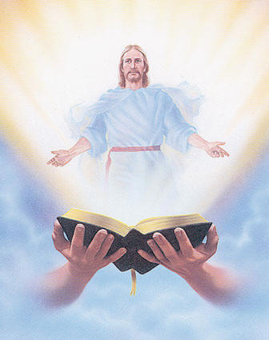
Welcome
Guest

Slide 3
ANNOUNCEMENTS
July 14, 2017

Slide 4
August 2017 MAGNIFICAT ISSUE
is available for
distribution tonight
at the Auditorium.

Slide 5
Save the Date!
Disciples Assembly
"We Walk Hand In Hand"
July 29, 2017, Saturday
1:00 pm to 5:00 pm
DMP Auditorium
Contacts: Lisa and Joven Soriano, Joy and Raul Wong, Tatess and Tony Abad, Fe and Sundee Ikalina, Nellie and Ernest Sun
Notes:
Knowing current BLD trends and issues and how the community and its leadership move to worship and serve God.

Slide 6
August 19, 2017
Community Celebration at the
Divine Mercy Parish
August 20, 2017
25th Anniversary Dinner Dance

Slide 7
Marshaling
Schedule
JULY 21, 2017
Pastoral
Apostolate

Slide 8
ORDER
“Whoever has ears ought to hear.”
(Mt 13:9)

Slide 9
DIRECTION
Honor God’s word by
studying, meditating,
accepting and living by it.

