Slide 1
ANNOUNCEMENTS
Jan. 11, 2019

Slide 2
God’s Promise for the week
“… Upon whom I have put my spirit; he shall bring forth justice to the nations.”
Is 42:1b
Notes:
2

Slide 3
Welcome
Guest

Slide 4
BLD Family Health
and Wellness Day
Tomorrow
JAN 12, 2019, 1- 4 pm
@DMP Gym

Slide 5
Friday, January 18, 2019
Washington, DC
Contact: Ray Salmo at (732)766 -1785
raycsalmo@gmail.com
Notes:
To save a seat on the BLD Newark bus that will go to the March for Life on January 18
, please contact Ray Salmo at (732)766-1785 / raycsalmo@gmail.com

Slide 6
TEACHINGS
NCR/GIP – ME 47,49,50 /
SPE 20 / SE 38
CMP II, Part 1 - LSS 1- 48 / ME48
/ SPE 19
Sat., Jan. 19, 2019, 1- 6 pm
@ DMP Classroom

Slide 7
2000 Hail Mary’s for the Medical Mission –
Saturday,
January 26, 8 am to 5 pm,
@DMP Rm 204

Slide 8
Marshaling
Schedule
Jan. 18, 2019
Formation
Apostolate

Slide 9
ORDER
“Give to the Lord the glory due his name.”
Ps 29:2a

Slide 10
DIRECTIONS
Pray, repent and be reconciled
with your brethren.
2. Adhere to our community norms
and values.
3. Invite others to Life in the Spirit
Seminar and all the encounters.

Slide 11
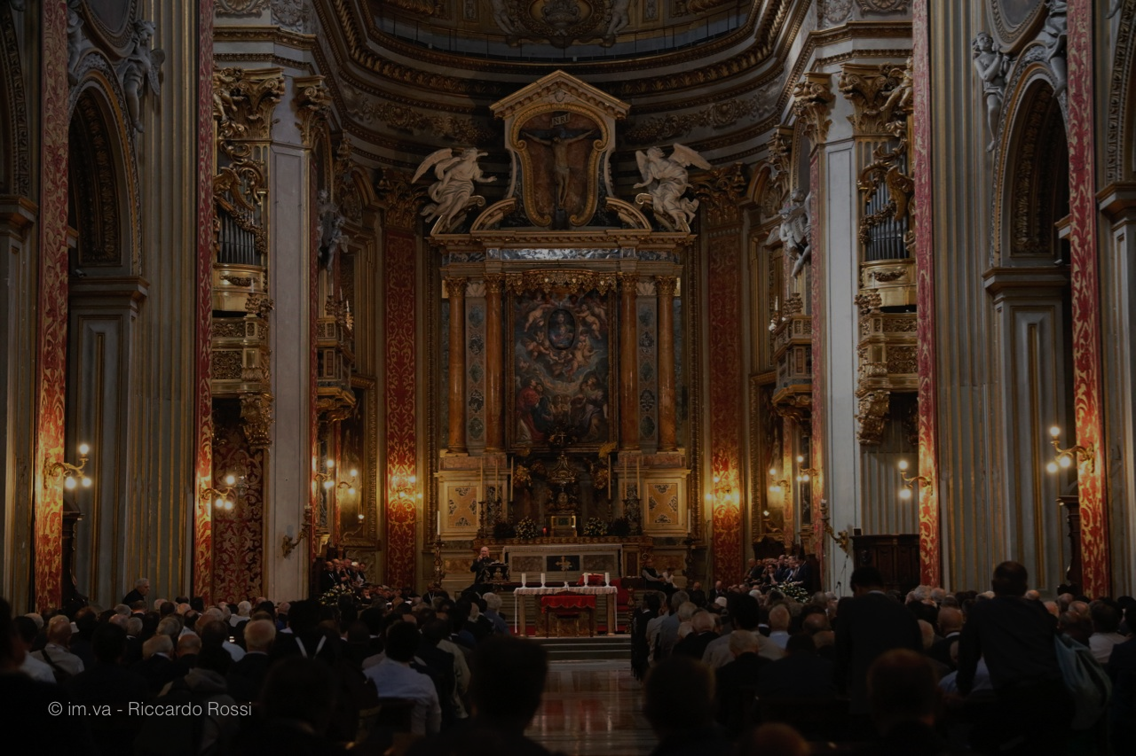
Please maintain REVERENCE
at all times while
we are still in the
House of God.

