Slide 1
ANNOUNCEMENTS
Dec. 6, 2019

Slide 2
God’s Promise for the week
“He shall have pity for the lowly and the poor; the lives of the poor he shall save.”
Ps 72:13
Notes:
2

Slide 3
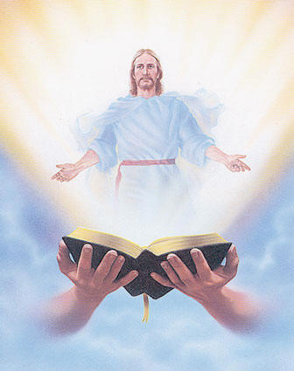
Welcome
Guest

Slide 4
ME #53
Grand Reunion
Dec. 7, 2019
12 pm – 5pm
Divine Mercy Parish Library

Slide 6
YLSS Salubungan
January 3, 2020

Slide 7
FRIDAY, JANUARY 24, 2020
Washington DC
Contact:
Ray Salmo at RayCSalmo@gmail.com or any Mission Apostolate member
Bus leaves DMP parking lot at 6:30 AM
Notes:
Those who would like to signup as volunteer marchers during the March for Life, please contact Ray Salmo at RayCSalmo@gmail.com, or any member of the Mission Apostolate.
The bus for marchers will be leaving DMP parking at 6:30 AM on Jan 24, 2020 (Friday).

Slide 8
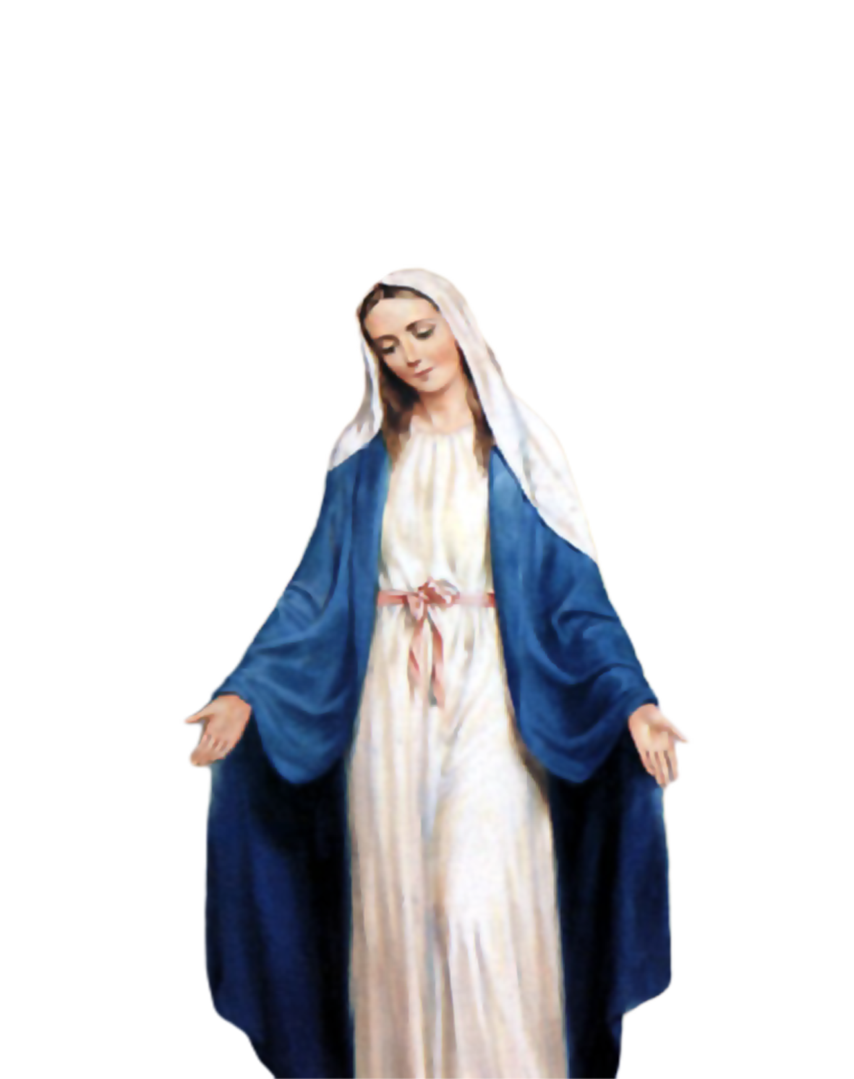
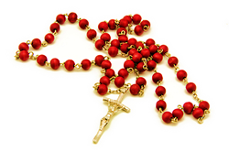
Medical Mission 2020
Jordan, Guimaras, Philippines
February 10 to 13, 2020
2000 Hail Mary’s for the Medical Mission
Saturday, January 25, 2020
at the DMP Library

Slide 9
Marshaling
Schedule
Dec. 13, 2019
Management
Apostolate

Slide 10
ORDER
“…Prepare the way of the Lord, make straight his paths.”
Mt 3:3b

Slide 11
DIRECTION
Practice the steps of repairing wrongdoing: Recognition, Remorse, Renunciation, Restitution and Reconciliation.

