Slide 1
ANNOUNCEMENTS
Oct. 25, 2019

Slide 2
God’s Promise for the week
“The Lord is close to the broken-hearted; and
those who are crushed
in spirit he saves.”
Ps 34: 19
Notes:
2

Slide 3
Welcome
Guest

Slide 4
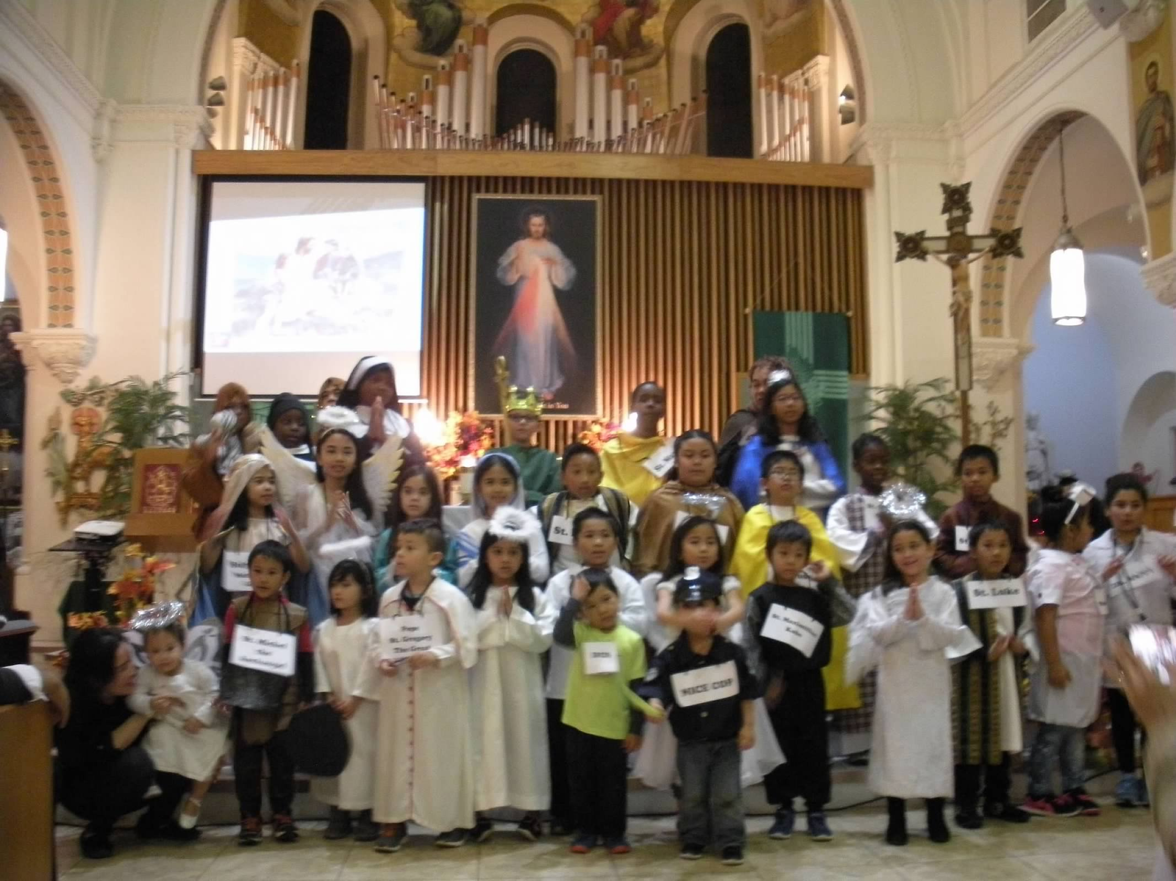
Parade of Saints
by MARK 10
Friday, Nov. 1, 2019
Divine Mercy Parish.
** Before recessional of Healing Mass, please bring
treats and candies for Mark 10 children.

Slide 5
Prayer Healing
Seminar II
Nov. 23 - 24, 2019 7 am – 6 pm
2nd floor Library,
Divine Mercy Parish, Rahway, NJ
Email prayer.healing@BLDNewark.com to RSVP, or Register online at www. BLDNewark.com and click on
Prayer Healing Seminar II flyer
Notes:
All graduates of Prayer Healing Seminar 1 are invited to participate in the second part of this 2-part seminar /retreat.
Email prayer.healing@BLDNewark.com to RSVP, or Register online at www. BLDNewark.com and click on Prayer Healing Seminar II flyer

Slide 6
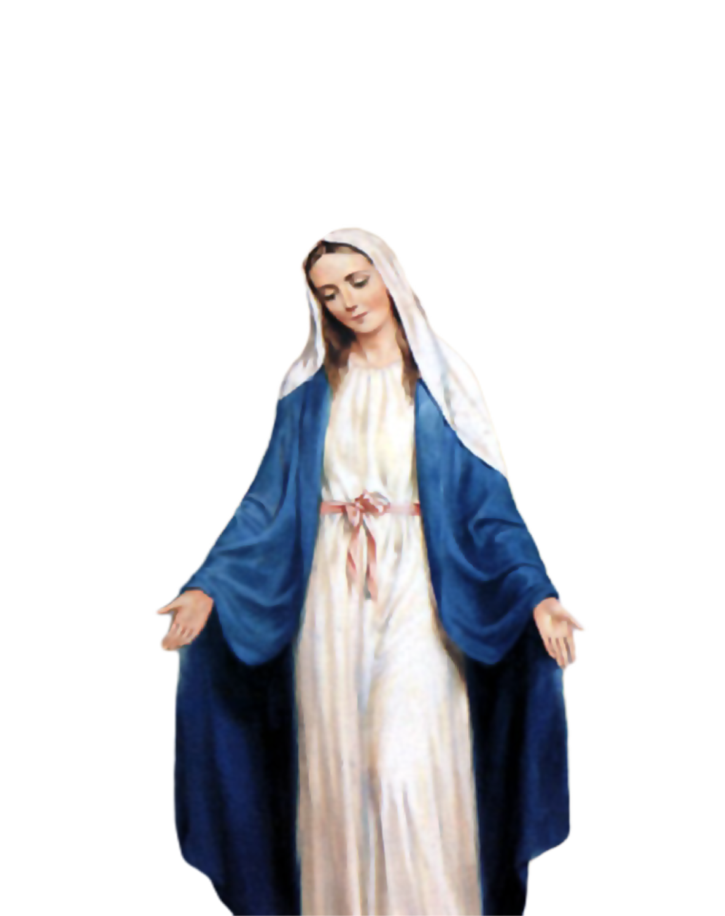
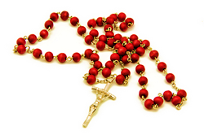
Medical Mission 2020
Jordan, Guimaras, Philippines
February 10 to 13, 2020
2000 Hail Mary’s for the Medical Mission
Saturday, January 25, 2020
at the DMP Library

Slide 7
FRIDAY, JANUARY 24, 2020
Washington DC

Slide 8
?
?
If you have questions
?
e-Giving
BLD
email
Photo ID
password reset
BLD Secretariat
Available tonight at the auditorium

Slide 9
Marshaling
Schedule
Nov. 1, 2019
Formation
Apostolate

Slide 10
ORDER
“Be merciful…”
Lk 18:13b

Slide 11
DIRECTIONS
Go to confession regularly.
Pray with a contrite heart.
Intercede & provide for the needs of the poor and lowly.

