Slide 1
ANNOUNCEMENTS
Nov. 29, 2019

Slide 2
God’s Promise for the week
“...those who love you prosper.”
Ps 122:6
Notes:
2

Slide 3
Welcome
Guest

Slide 4
ME #53
Grand Reunion
Dec. 7, 2019
12 pm – 5pm
Divine Mercy Parish Library

Slide 5
FRIDAY, JANUARY 24, 2020
Washington DC

Slide 6
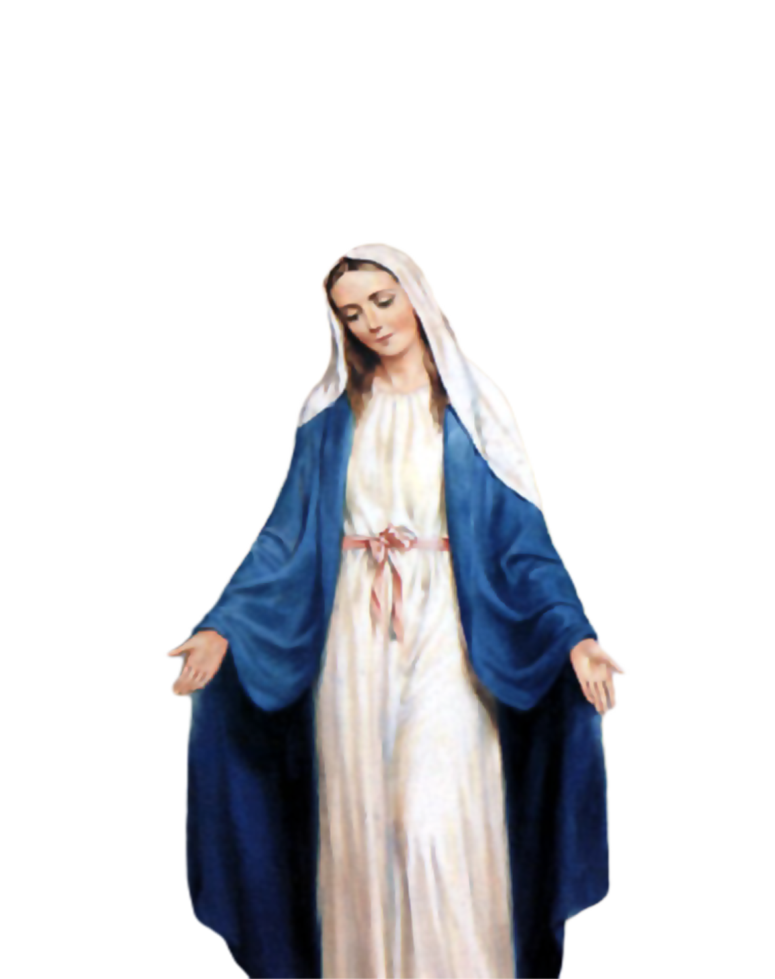
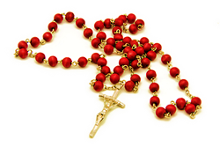
Medical Mission 2020
Jordan, Guimaras, Philippines
February 10 to 13, 2020
2000 Hail Mary’s for the Medical Mission
Saturday, January 25, 2020
at the DMP Library

Slide 7
Marshaling
Schedule
Dec. 6, 2019
Formation
Apostolate

Slide 8
ORDER
“...stay awake...be prepared...”
Mt 24:42a,44a

Slide 9
DIRECTIONS
1. Enter deeper into prayer, meditations and self-reflections.
2. Perform acts of kindness every day.
3. Conduct yourselves properly and make no provision for the desires of the flesh.

