Slide 1
ANNOUNCEMENTS
May 24, 2019

Slide 2
Welcome ME #52

Slide 3

God’s Promise for the week
“The Advocate, the Holy Spirit…will teach you everything and remind you of all that I told you.”
Jn 14:26
Notes:
3

Slide 4

Welcome
Guest

Slide 5

Notes:
Deadline to register is June 6th.
Venue: Sacred Heart Retreat Center
20 Old Swartswood Road Newton NJ 07860

Slide 6
PRAYER HEALING
SEMINAR I
June 22, 2019 - 7am-6pm June 23, 2019 - 7am-5pm Divine Mercy Parish Library, Rahway NJ.
Register online at www. BLDNewark.com
Notes:
All LSS graduates of BLD are invited to participate in this beautiful retreat. After more than 4 years, our community is again offering this moving recollection/seminar.
Limited to 50 participants, please register early.
Email prayer.healing@BLDNewark.com to RSVP, or Register online at www. BLDNewark.com and click on Prayer Healing Seminar I flyer.
There is a registration fee of $50 to cover handouts and food & snacks for both days.

Slide 7
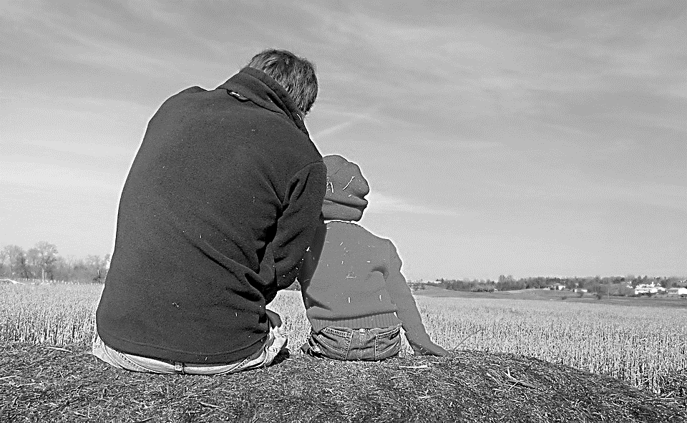
Solo Parents Encounter
Weekend #21
June 29-30, 2019
Days Hotel of East Brunswick
195 NJ 18 East Brunswick, NJ 08816
Please contact: Matt and Precy Yap

Slide 8


YOUTH
ENCOUNTER
#26
July 12 - 14, 2019
Fellowship Deaconry Ministries
3575 Valley Rd, Basking Ridge, NJ 07920
Contact: dyc@bldnewark.com

Slide 9


FAMILY
ENCOUNTER 26
As for me and my household, we will serve the Lord: Joshua 24:15
July 26 -28, 2019
Malvern Retreat House
Malvern PA
Contacts:
Mike and Emma Pepino, Ed and Susan Fabe

Slide 10
Marshaling
Schedule
May 31, 2019
Pastoral
Apostolate

Slide 11
ORDER
“Do not let your hearts be troubled
or afraid.”
Jn 14:27b

Slide 12
DIRECTIONS
In prayer and petition, lift up everything to Him.
Read and reflect on God’s word daily.

