Slide 1
ANNOUNCEMENTS
June 21, 2019

Slide 2

God’s Promise for the week
"They ate and were satisfied."
Lk 9:17a
Notes:
2

Slide 3
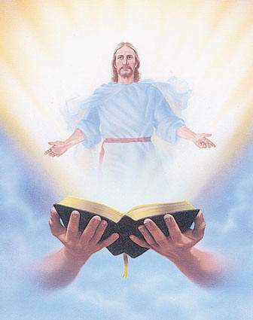
Welcome
Guest

Slide 4
PRAYER HEALING
SEMINAR I
June 22, 2019 - 7am-6pm June 23, 2019 - 7am-5pm Divine Mercy Parish Library, Rahway NJ.
Register online at www. BLDNewark.com
Notes:
All LSS graduates of BLD are invited to participate in this beautiful retreat. After more than 4 years, our community is again offering this moving recollection/seminar.
Limited to 50 participants, please register early.
Email prayer.healing@BLDNewark.com to RSVP, or Register online at www. BLDNewark.com and click on Prayer Healing Seminar I flyer.
There is a registration fee of $50 to cover handouts and food & snacks for both days.

Slide 5
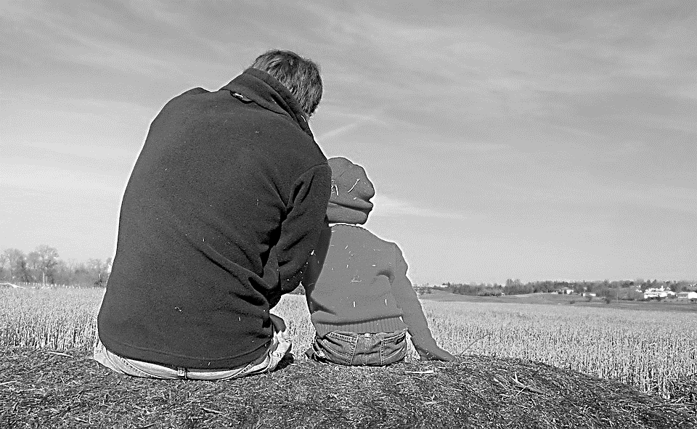
Solo Parents Encounter
Weekend #21
June 29-30, 2019
Days Hotel of East Brunswick
195 NJ 18 East Brunswick, NJ 08816
Please contact: Matt and Precy Yap

Slide 6
Save the Date!
Msgr. Paul Schetelick’s 70th Birthday &
43rd Sacerdotal Anniversary Celebration
July 6, 2019
Eucharistic Celebration at 5:30 pm, Divine Mercy Church, Rahway, NJ
Reception to follow in the DMP Auditorium
Notes:
Please visit bldnewark.com to RSVP

Slide 7
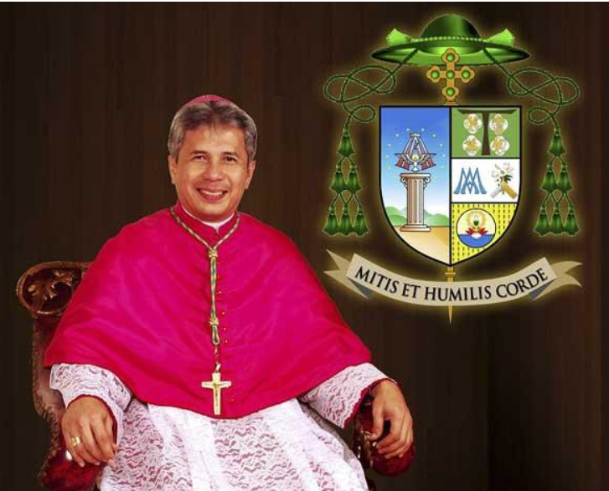
Invitation to Bishop Reynaldo G. Evangelista First U.S. Pastoral Visit
July 13, 2019 Saturday, 12pm
to 8:30 pm @DMP
Visit bldnewark.com
for details
Notes:
Please visit bldnewark.com to RSVP

Slide 8


YOUTH
ENCOUNTER
#26
July 12 - 14, 2019
Fellowship Deaconry Ministries
3575 Valley Rd, Basking Ridge, NJ 07920
Contact: dyc@bldnewark.com

Slide 9
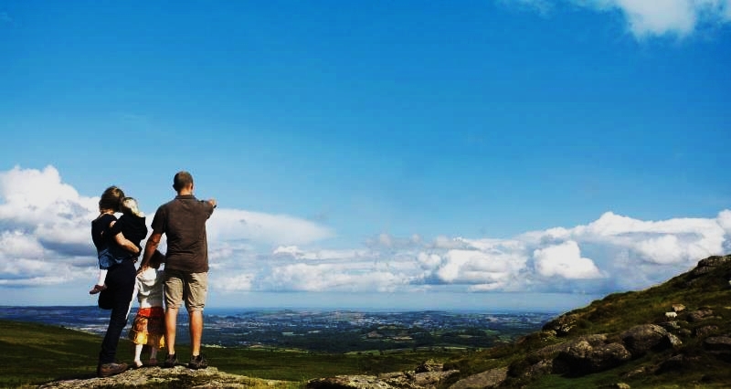

FAMILY
ENCOUNTER 26
As for me and my household, we will serve the Lord: Joshua 24:15
July 26 -28, 2019
Malvern Retreat House
Malvern PA
Contacts:
Mike and Emma Pepino, Ed and Susan Fabe

Slide 10
Marshaling
Schedule
June 28, 2019
Management
Apostolate

Slide 11
ORDER
“… This is my body that is for you. Do this in remembrance
of me… This cup is the new covenant in my blood. Do this,
as often as you drink it, in remembrance of me.”
1 Cor 11:24-25

Slide 12
DIRECTIONS
Receive Holy Communion regularly.
Feed the hungry and share your resources
with the needy.

