Slide 1
ANNOUNCEMENTS
June 14, 2019

Slide 2

God’s Promise for the week
“He will not speak on his own, but he will speak what he hears, and will declare to you the things that are coming.”
Jn 16:13b
Notes:
2

Slide 3

Welcome
Guest

Slide 4
JuLY 2019
MAGNIFICAT ISSUE
is available for
distribution tonight
at the Auditorium.

Slide 5
TEACHINGS
Sienna Gift Inventory- LSS 1- 51
ME 47-51 ; SPE 19-21
Prayer Leadership - LSS 1- 48 & Disciplees
Sat., June 15, 2019, 1- 6 pm
@ DMP Classroom

Slide 6
PRAYER HEALING
SEMINAR I
June 22, 2019 - 7am-6pm June 23, 2019 - 7am-5pm Divine Mercy Parish Library, Rahway NJ.
Register online at www. BLDNewark.com
Notes:
All LSS graduates of BLD are invited to participate in this beautiful retreat. After more than 4 years, our community is again offering this moving recollection/seminar.
Limited to 50 participants, please register early.
Email prayer.healing@BLDNewark.com to RSVP, or Register online at www. BLDNewark.com and click on Prayer Healing Seminar I flyer.
There is a registration fee of $50 to cover handouts and food & snacks for both days.

Slide 7
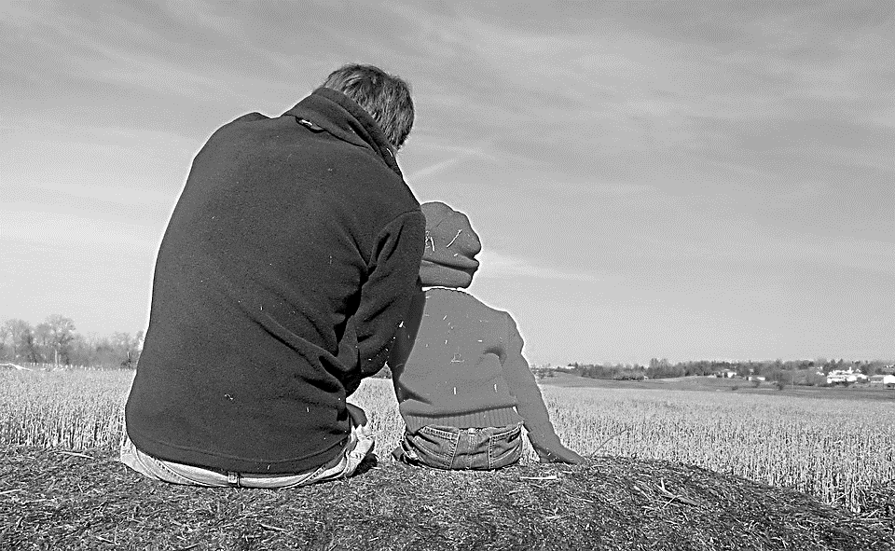
Solo Parents Encounter
Weekend #21
June 29-30, 2019
Days Hotel of East Brunswick
195 NJ 18 East Brunswick, NJ 08816
Please contact: Matt and Precy Yap

Slide 8
Save the Date!
Msgr. Paul Schetelick’s 70th Birthday &
43rd Sacerdotal Anniversary Celebration
July 6, 2019
Eucharistic Celebration at 5:30 pm, Divine Mercy Church, Rahway, NJ
Reception to follow in the DMP Auditorium
Notes:
Please visit bldnewark.com to RSVP

Slide 9
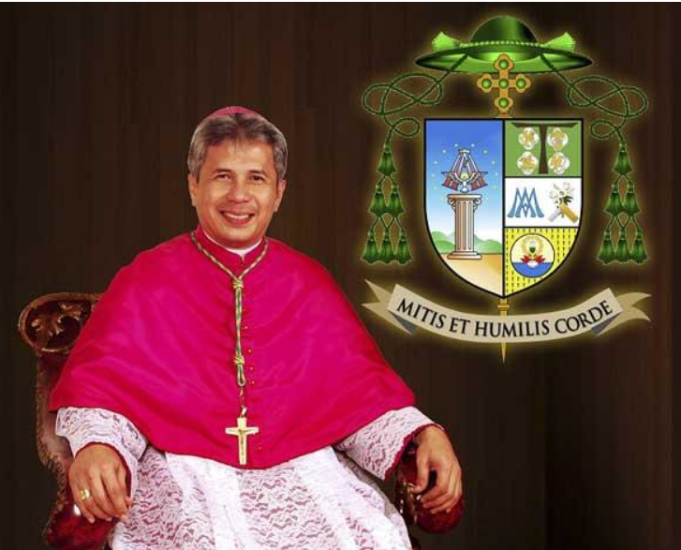
Invitation to Bishop Reynaldo G. Evangelista First U.S. Pastoral Visit
July 13, 2019 Saturday, 12pm
to 8:30 pm @DMP
Visit bldnewark.com
for details
Notes:
Please visit bldnewark.com to RSVP

Slide 10


YOUTH
ENCOUNTER
#26
July 12 - 14, 2019
Fellowship Deaconry Ministries
3575 Valley Rd, Basking Ridge, NJ 07920
Contact: dyc@bldnewark.com

Slide 11
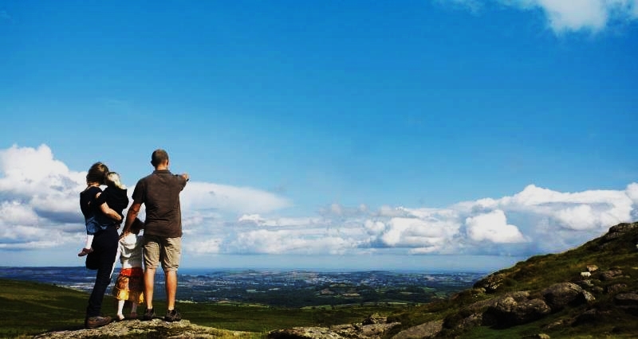

FAMILY
ENCOUNTER 26
As for me and my household, we will serve the Lord: Joshua 24:15
July 26 -28, 2019
Malvern Retreat House
Malvern PA
Contacts:
Mike and Emma Pepino, Ed and Susan Fabe

Slide 12
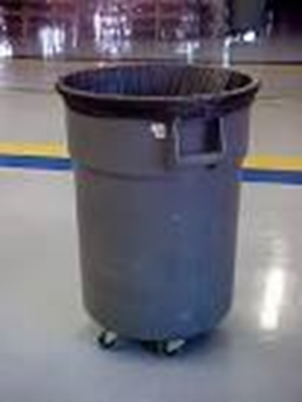
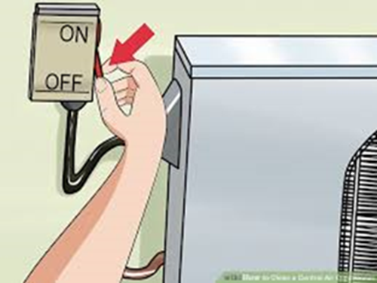
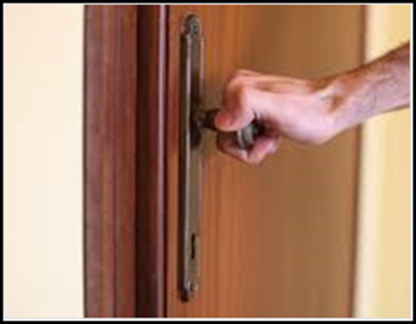
General House Rules
Keep all rooms, including the Gymnasium, Auditorium, Connell Hall & Library, neat and clean. Empty trash bins in the dumpster.
Make sure all the windows & doors are closed, lights and air conditioner/electric fan are turned off, including in the Gym, Auditorium, Connell Hall & Library.
Report issues with any of the building doors, e.g. the door could not be locked or closed, to Vino/Beth Guiang, so that Fr. Alex is notified for security purposes.

Slide 13
Marshaling
Schedule
June 21, 2019
Pastoral
Apostolate

Slide 14
ORDER
“… boast in hope of the glory of God... through the Holy Spirit that has been given to us.”
Rom 5:2,5

Slide 15
DIRECTIONS
Open your hearts and be transformed by the Holy Spirit.
Go out and spread God’s love through words and deeds.

