Slide 1
ANNOUNCEMENTS
Jan. 4, 2019

Slide 2
God’s Promise for the week
“…He shall rescue the poor when he cries out, and the afflicted when he has no
one to help him.”
Ps 72:12
Notes:
2

Slide 3
Welcome
Guest

Slide 4
SAVE THE DATE
JAN 12, 2019
Family Health
Day Activities

Slide 5
Friday, January 18, 2019
Washington, DC
Contact: Ray Salmo at (732)766 -1785
raycsalmo@gmail.com
Notes:
To save a seat on the BLD Newark bus that will go to the March for Life on January 18
, please contact Ray Salmo at (732)766-1785 / raycsalmo@gmail.com

Slide 6
YLSS #24
Youth Life in the Spirit Seminar
March 1-3, 2019
Divine Mercy Auditorium
Contacts:
Mario and Carmen Olazo (732-951-2189)
William and Maria Sumandal (732-500-3988)
Archie and Lelet Quevada (732-910-7085)
Email address: dyc@bldnewark.com
BLD Newark

Slide 7
Marshaling
Schedule
Jan. 11, 2018
Evangelization
Apostolate

Slide 8
ORDER
“… pay him homage...”
Ps 72:11

Slide 9
DIRECTIONS
Spend time in prayer, word reflection and worship regularly.
Share your spiritual gifts with others.
Be generous in your tithes and love offering.

Slide 10
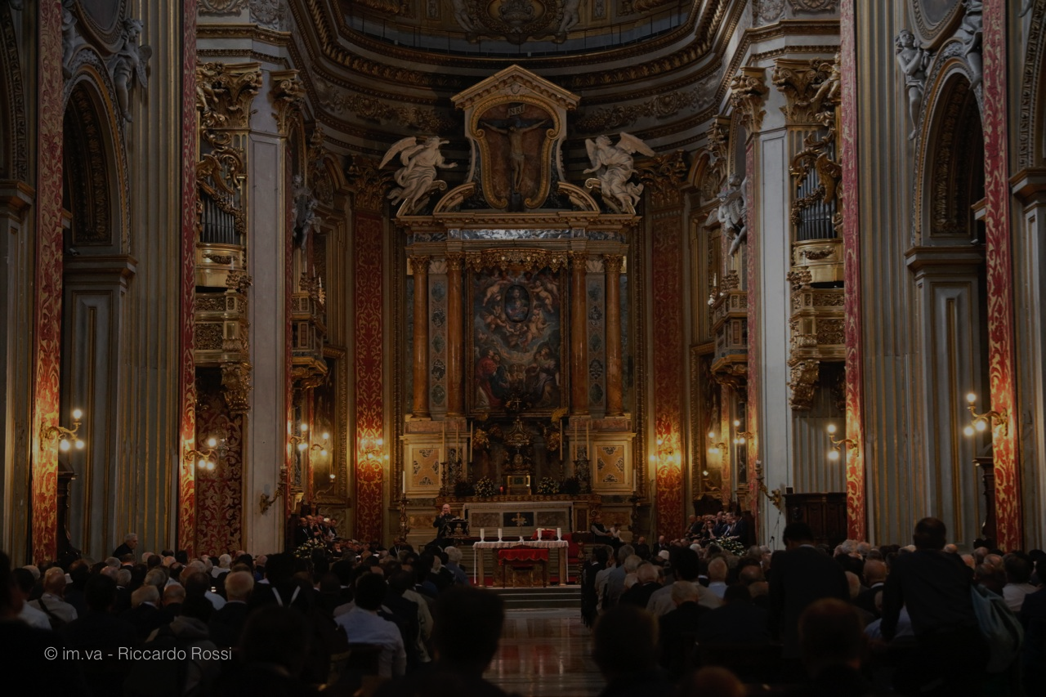
Please maintain REVERENCE
at all times while
we are still in the
House of God.

