Slide 1
ANNOUNCEMENTS
Feb. 1, 2019

Slide 2
God’s Promise for the week
“…I am with you
to deliver you.”
Jer 1:19b
Notes:
2

Slide 3
Welcome
Guest

Slide 4
TEACHINGS
NCR/GIP – ME 47,49,50 /
SPE 20 / SE 38
CMP II, Part 1 - LSS 1- 48 / ME48
/ SPE 19
Sat., Feb. 2, 2019, 1- 6 pm
@ DMP Classrooms
Notes:
Due to inclement weather, teachings for tomorrow is cancelled.

Slide 5
TEACHINGS
Basic Bible Seminar - LSS 1- 50/ ME 47, 49,
50/ SPE 20
CMP 2 Part II - LSS 1- 48 / ME 48 /SPE 19
Sat., Feb. 16, 2019, 1- 6 pm
@ DMP Classrooms

Slide 6
Marriage Encounter
Weekend 52
18th -19th of May 2019
Sacred Heart Center, Newton, New Jersey
I hold you in my heart, for we have shared together God’s blessing.
Philippians 1:7
Please contact mla@bldnewark.com
BLD Newark

Slide 7
Marshaling
Schedule
Feb. 8, 2019
Pastoral
Apostolate

Slide 8
ORDER
“…stand up and tell them all that I
command you.”
Jer 1:17a

Slide 9
DIRECTIONS
Actively participate in the social teachings of the church especially the
right to Life.
Be bold in sharing your
faith with others.

Slide 10
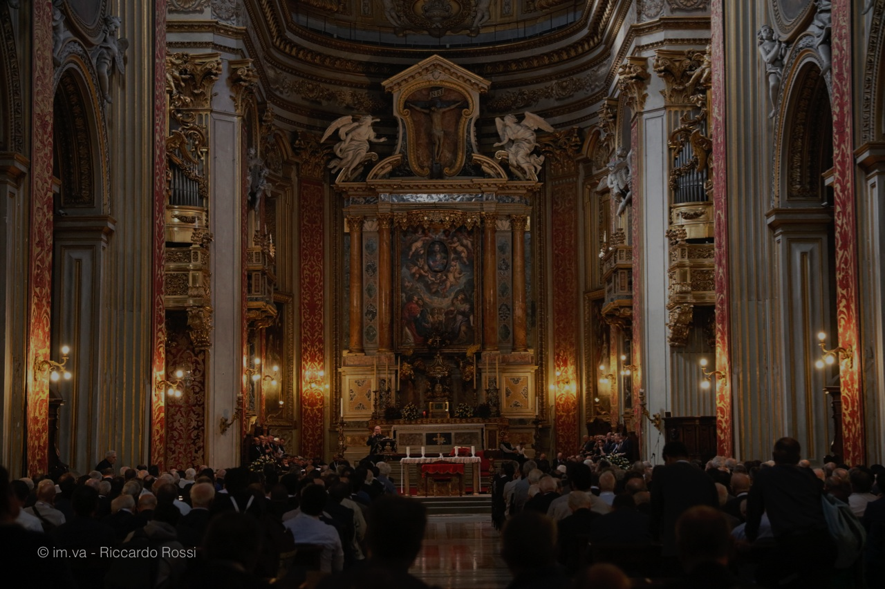
Please maintain REVERENCE
at all times while
we are still in the
House of God.

