Slide 1
ANNOUNCEMENTS
Aug. 30, 2019

Slide 2
God’s Promise for the week
“Humble yourself the more…and you will find favour with God.”
Sir 3:18
Notes:
2

Slide 3
Welcome
Guest

Slide 4
“Breaking
the Silence”
A Symposium on Depression
Led by Msgr. Paul Schetelick
and a Multidisciplinary team.
August 31, 2019 1pm - 6pm,
St. Elizabeth of Hungary Parish Church
179 Hussa St., Linden, NJ 07036
Please RSVP at http://bldnewark.com
Notes:
Youth, Singles and Parents are all invited, Please RSVP at bldnewark.com

Slide 5
Life in the
Spirit
Seminar #52
October. 4 - 6, 2019
Salubungan is on September 6, 2019
Contacts: Earl & Flo Manguiat
bldnewarklsa@gmail.com
BLD Newark
Notes:
Online registration is available at bldnewark.com website

Slide 6
BLD NEWARK
2019 Community Fundraising Event
Drawing
Oct. 18, 2019 @ 10:30pm
@ Divine Mercy Parish
1st | 9-Day Trip to the Holy Land for 2 Mar 29-Apr 8, 2020 | $7,000
2nd | 5-Night Cruise to Bermuda for 2 Oct 31-Nov 5, 2020 | $1,264
3rd | Samsung 43” Class 4K UHD LED LCD Smart TV | $280
Other | 10 Consolation Gift Cards of $100 each | $1,000

Slide 7
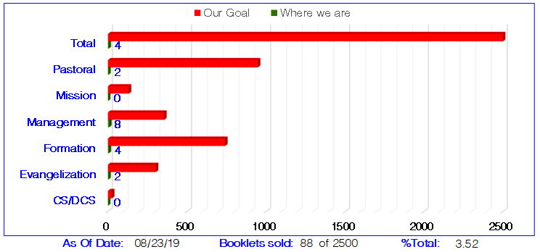
BLD NEWARK
2019 Community Fundraising Event
Fundraising Committee Members will be at the back of the auditorium before & after worship,
to collect ticket and remittance form with payments, and to answer any questions.
Remittance forms are available @ www.bldnewark.com
Notes:
Please Read:
Here is the most recent progress report from the Fundraising Committee. Approximately 3.5% or 85 of 2,500 booklets were remitted and payments collected. We encourage all members to remit sold tickets on Fridays, before or after worship, so our fundraising progress may be properly monitored and reported. We are showing results per Apostolate, so that each group may monitor their own progress, Let us all strive to do our personal best, so our community may continue to fund all our works of mercy, especially the yearly Medical Mission.

Slide 8
Marshaling
Schedule
Sept. 6, 2019
Mission
Apostolate

Slide 9
2020 Magnificats Renewal
Deadline: Oct 11, 2019
Please submit orders and payments per Ministry/or M.E. class to Marc / Emma.
Notes:
Starting next month, September 6, we will be accepting orders for the 2020 Magnificat. Rates are the same:
English (regular print) - $22.00
Spanish - $19.95
Magnifikids - $12.30
Large Print - $39.95
Deadline for submitting orders per ministry/ME will be OCTOBER 11.
We will not be accepting orders AFTER THE DEADLINE (OCTOBER 11).
You can either pay by check (payable to BLD Newark) or cash.

Slide 10
ORDER
“…go and take the lowest place…”
Lk 14:10a

Slide 11
DIRECTION
Serve the least of our brethren.

